Slide 1
My patient has normal coronaries and still has chest pain: What do I do?
Dr Mrinal Saha
Consultant Cardiologist
MBBS MA(Cantab) FRCP PhD
www.drmrinalsaha.com

Slide 2
Consultant Cardiologist since 2010 at GHNHSFT
Coronary intervention (1:6 PPCI rota)
1994- Trinity College Cambridge
1997- Barts and the London
Cardiology: London Chest/Barts, St Thomas’s (PhD)
Cleveland Clinic London

Slide 3
Objectives
Review a typical patient
Understand pathophysiology
Initiate appropriate management
Typical treatment pathway
Emerging treatments

Slide 4
Case
60 yr old female
Increasingly short of breath, some chest tightness at rest, not on exertion
No palpitations or dizzy spells
Non smoker
No FH of IHD
On no regular medications

Slide 5
examination
BMI 25
Pulse 64
BP 160/80
HS I+II, no murmur
Clear chest
No peripheral oedema

Slide 6
investigations
Hb 130
EGFR 70
TSH 2
TC 4.8
BNP 380

Slide 7
ECG

Slide 8
Case ctd.
Trial of GTN spray
Advised to seek further help if pain recurs
Referral to RACPC made
Episode of severe prolonged chest pain
Seen in ED
Troponin 16, 17
”GP to refer to RACPC”

Slide 9
Referred to RACPC→ CTCA
“Normal coronaries”
Pt discharged back to GP
What do you do?

Slide 10
Differential diagnosis of chest pain with no coronary artery disease
Non-cardiac chest pain
Microvascular angina (MVA)

Slide 11
Heberden’s description of Angina 1772:
But there is a disorder of the breast marked with strong and peculiar symptoms, considerable for the kind of danger belonging to it, and not extremely rare, which deserves to be mentioned more at length. The seat of it, and sense of strangling, and anxiety with which it is attended, may make it not improperly be called angina pectoris. They who are afflicted with it, are seized while they are walking, (more especially if it be up hill, and soon after eating) with a painful and most disagreeable sensation in the breast, which seems as if it would extinguish life, if it were to increase or to continue; but the moment they stand still, all this uneasiness vanishes. In all other respects, the patients are, at the beginning of this disorder, perfectly well, and in particular have no shortness of breath, from which it is totally different. The pain is sometimes situated in the upper part, sometimes in the middle, sometimes at the bottom of the os sterni, and often more inclined to the left than to the right side. It likewise very frequently extends from the breast to the middle of the left arm. The pulse is, at least sometimes, not disturbed by this pain, as I have had opportunities of observing by feeling the pulse during the paroxysm. Males are most liable to this disease, especially such as have past their fiftieth year. After it has continued a year or more, it will not cease so instantaneously upon standing still; and it will come on not only when the persons are walking, but when they are lying down, especially if they lie on the left side, and oblige them to rise up out of their beds. In some inveterate cases it has been brought on by the motion of a horse, or a carriage, and even by swallowing, coughing, going to stool, or speaking, or any disturbance of mind. Such is the most usual appearance of this disease; but some varieties may be met with. Some have been seized while they were standing still, or sitting, also upon first waking out of sleep; and the pain sometimes reaches to the right arm, as well as to the left, and even down to the hands, but this is uncommon: in a very few instances the arm has at the same time been numbed and swelled.

Slide 12
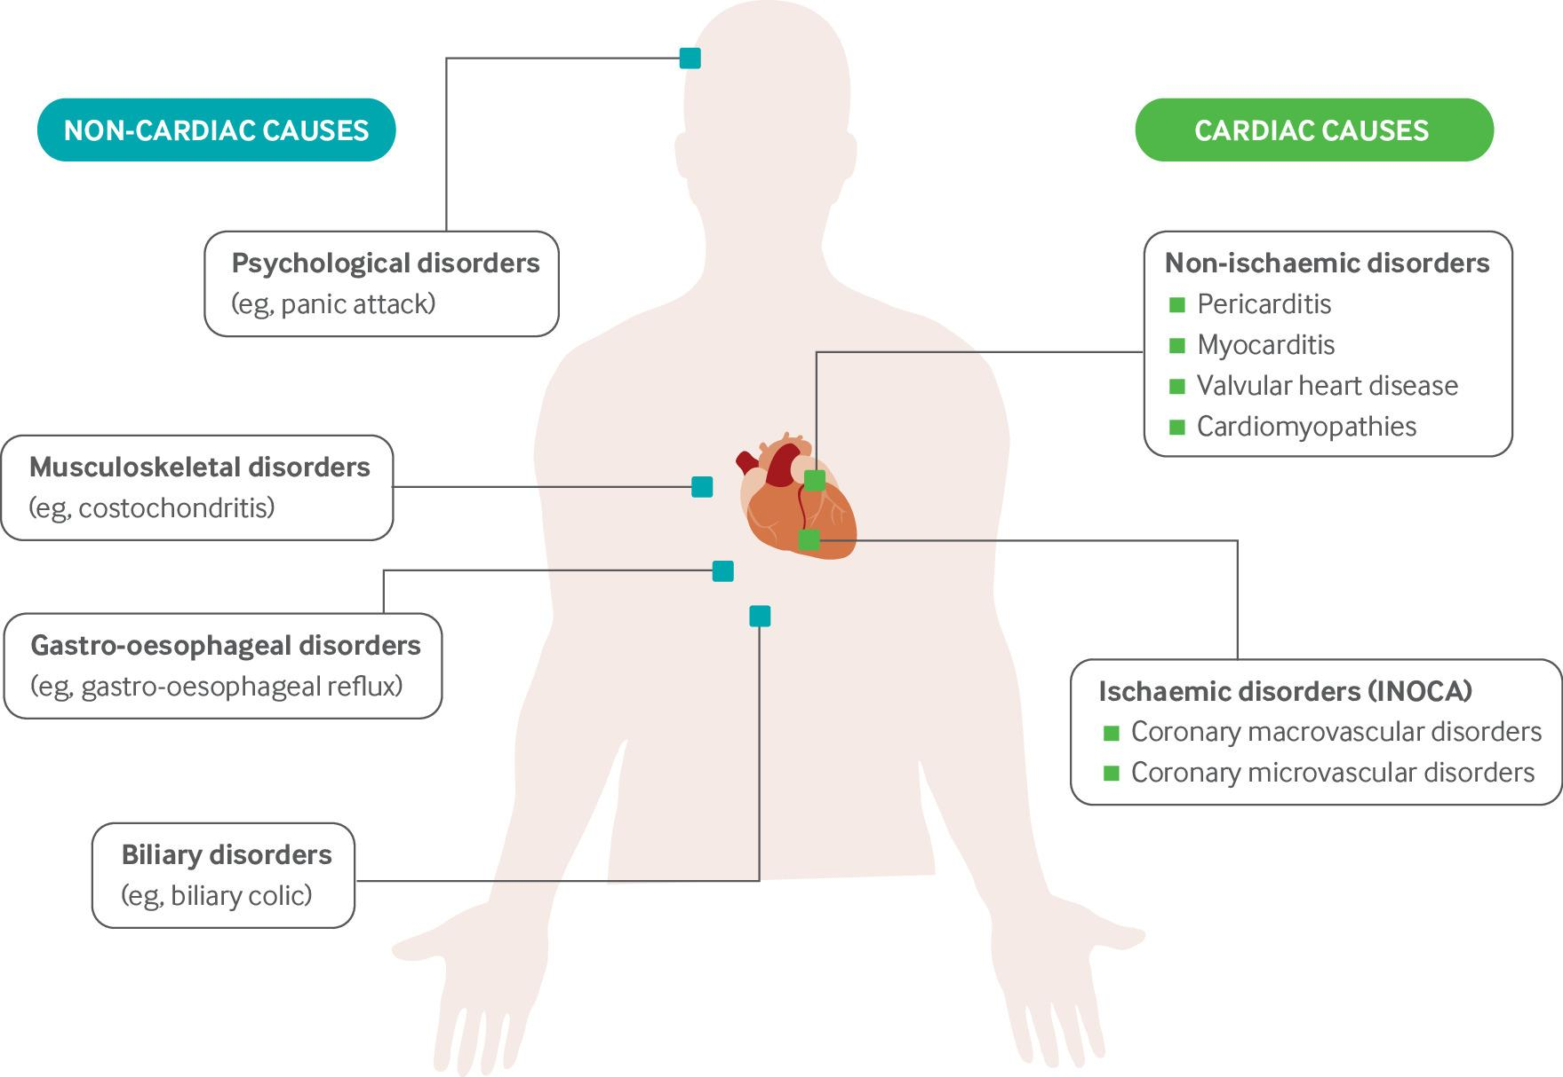
differential diagnosis of chest pain with no coronary artery disease
Common causes of chest pain in patients with non-obstructive coronary arteries.
Notes:
Common causes of chest pain in patients with non-obstructive coronary arteries. INOCA=ischaemia with non-obstructive coronary arteries

Slide 13
Cardiac causes of chest pain with no coronary disease
Angina with normal coronaries (ANOCA), Microvascular angina (MVA)
Prinzmetal angina
Coronary vasospasm
Syndrome X
INOCA (ischaemia with normal coronary arteries)

Slide 15
Why treat?
It’s a big problem!
59% of patients undergoing angiography for “angina” have normal coronaries (2010)- before the era of CTCA Increased risk of major adverse cardiovascular events (MACE)
3-4X increase risk of hospital admission
High healthcare burden
Functional limitations on the patient/ reduced QOL

Slide 16
Printzmetal Angina( Variant Angina/ Vasospastic Angina)
Typically younger than patients with classic angina
Typically smokers
Usually unexplained chest pain at rest, not related to exertion, occurs in clusters
Often at early in morning or at night
Usually only mild coronary artery disease on CTCA or invasive angiography, unremarkable treadmill test
Usually favourable prognosis
A small proportion may develop severe vasospasm that lead to MI/ ventricular arrhythmias/ cardiac arrest- but ECG changes can return to baseline within minutes

Slide 18
An extreme case of coronary vasospasm

Slide 19
Printzmetal Angina: Typical triggers and causes
“recreational” drugs- cocaine, ecstasy
Beta-blockers- vasospasm in pts with vasospastic angina, but beneficial in microvascular disease
Serotonin uptake inhibitors- vasospasm
Ergonovine (uterine contraction)
Chemotherapy agents- 5FU, capecitabine
Energy drinks
Mental stress

Slide 20
Printzmetal Angina: Typical treatments
Nitrates- GTN spray for acute attacks
CCB’s (amlodipine, nifedipine, diltiazem)
Nicorandil
aerobic exercise training
- stents don’t help!

Slide 21
Microvascular angina
MVA Commoner in females (9:1), obese, hypertensive, diabetes, high lipids
Can occur at rest or exercise
Typified by high resistance in microvasculature
Treatments: heart rate reducing drugs, nitrates (variable), exercise training, cardiac rehab, relaxation therapy, plus
Nicorandil
Ranolazine
Ivabradine
ACE-inhibitors
Statins
Trimetazidine

Slide 23
Covadis Criteria to diagnose patients with Vasospastic Angina
1) Nitrate responsive angina
2) Transient ECG changes
3) Coronary artery spasm
(a) Rest angina—especially between night and early morning (b) Marked diurnal variation in exercise tolerance—reduced in morning (c) Hyperventilation can precipitate an episode (d) Calcium channel blockers (but not β-blockers) suppress episodes
(a) ST segment elevation ≥ 0.1 mV (b) ST segment depression ≥ 0.1 mV (c) New negative U waves
transient total or subtotal coronary artery occlusion (>90% constriction) with angina and ischaemic ECG changes either spontaneously or in response to a provocative stimulus (typically acetylcholine ergot, or hyperventilation)

Slide 24
Covadis Criteria to diagnose patients with Microvascular Angina

Slide 25
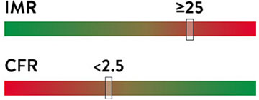
Assessing the coronary microcirculation in the cath lab

Slide 26
Diagnostic algorithm

Slide 27
So what would I do for this patient?
ensure the history is clear and accurate/ exclude non cardiac causes
obtain an ECG at the time of pain if possible (in patients with possible vasospastic angina); also request echo if ECG abnormal
manage risk factors (hypertension, diabetes, weight, cigarettes)
ensure pt is on aspirin, statin, ACE-I, prn GTN
initiate oral nitrates, BB, CCB, nicorandil, ranolazine in a step wise fashion (limited benefit of HRT as well as risks)
obtain an angiogram +/- invasive measurements at time of angiogram
Consider treadmill testing, or perfusion scanning is the diagnosis of ischaemia is uncertain
Increase exercise levels if on optimal therapy

Slide 28
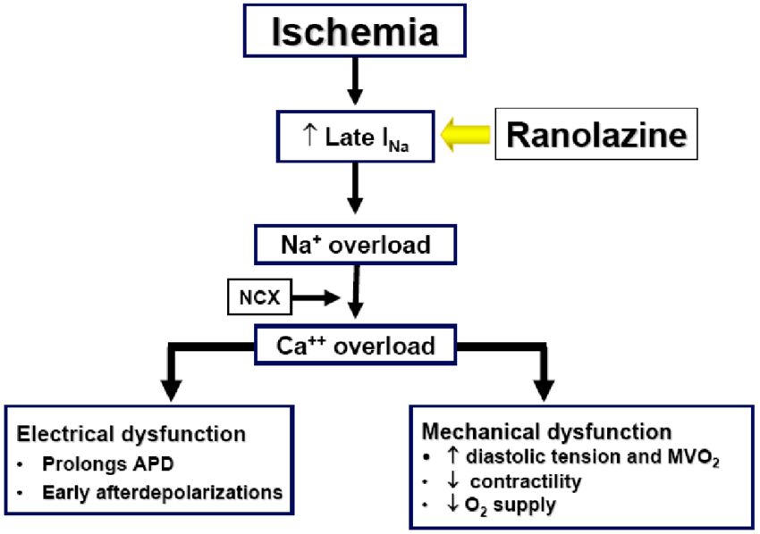
Ranolazine
Practical considerations: can impair renal function- so check U/E after starting it
Can prolong QTc- so needs pre and post treatment ECG
Mechanism of action:

Slide 29
Emerging treatments for MVA
Ticagrelor- as an adenosine uptake inhibitor→ vasodilation
Endothelin receptor blocker- Zibotentan (endothelin A receptor antagonist
Rhodiola rosea (“Arctic root/ Golden root”) – herbal medicine, blocks calcium channels in vascular smooth muscle cells
Autologous CD34 stem cell infusion- endothelium progenitor cells

Slide 30
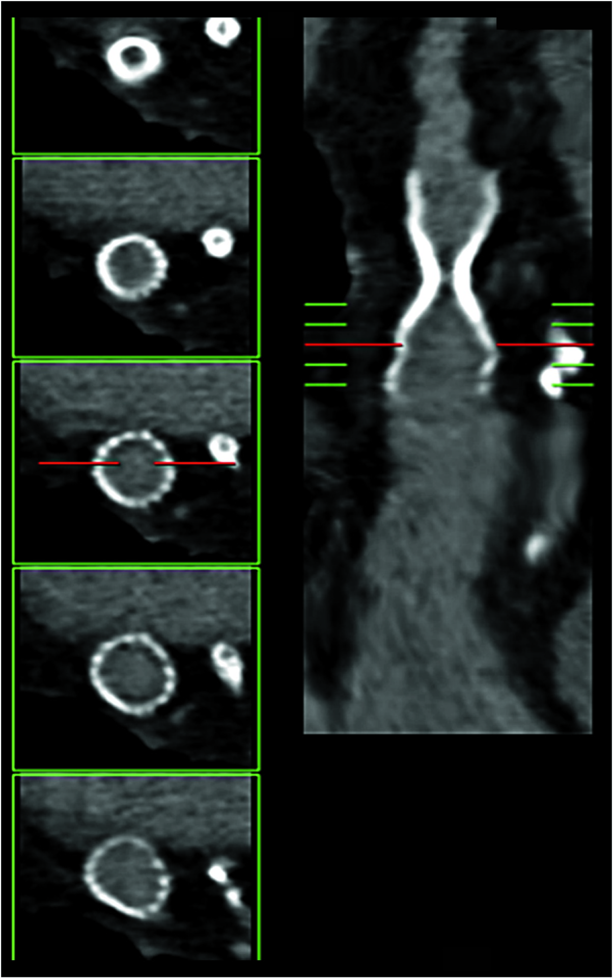
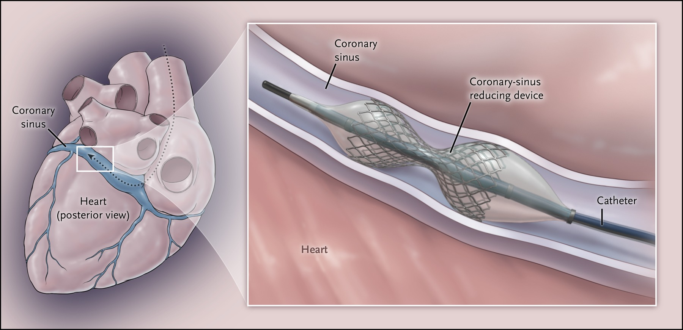
Emerging treatments
Coronary sinus reducer

Slide 31
Thank you for listening

